Slide 1
“Compiler Design
CSIT 5th
Semester

Slide 2
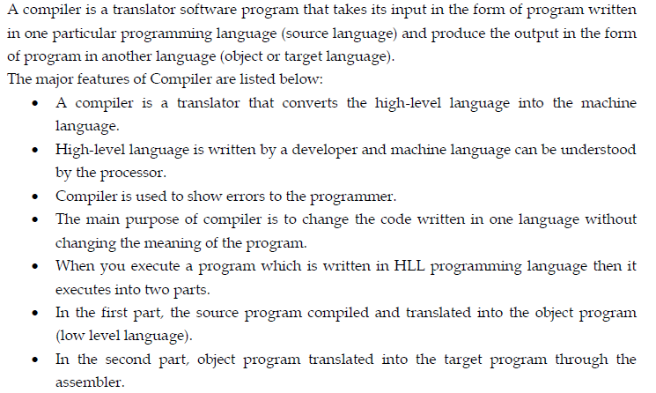
Introduction

Slide 3
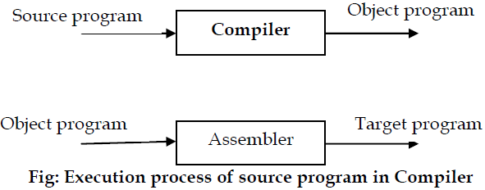

Slide 4
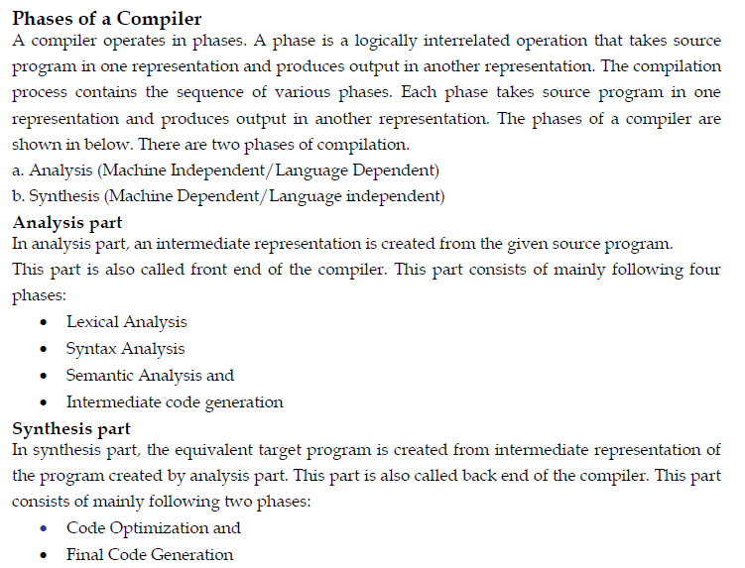

Slide 5
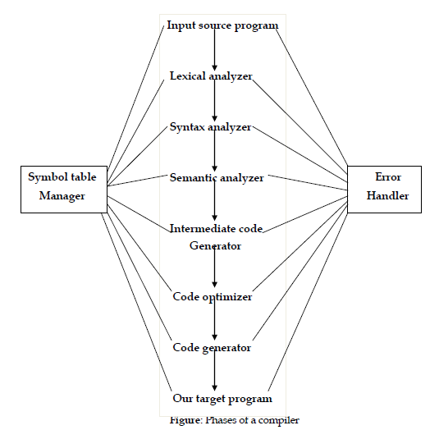
2222222222222222222222222222222222222222

Slide 6
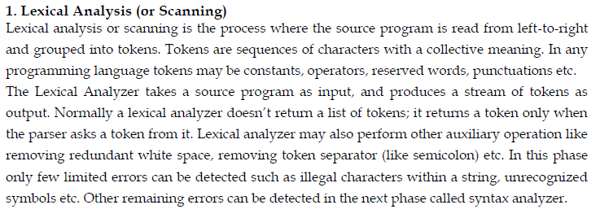

Slide 7
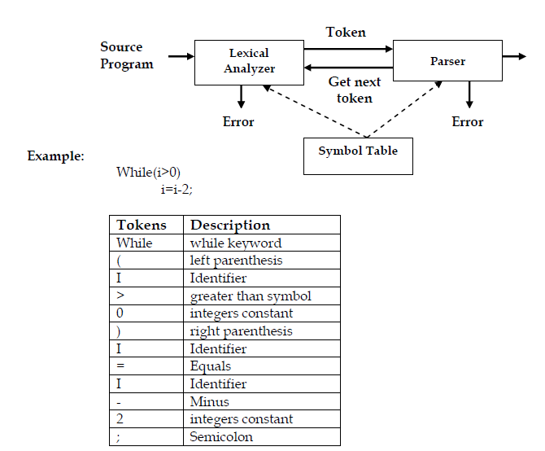

Slide 8
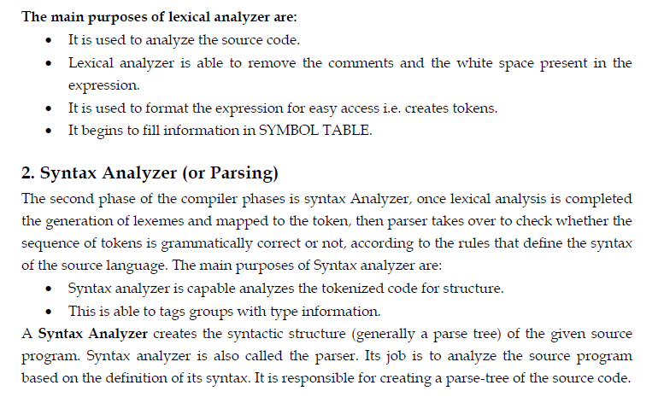

Slide 9
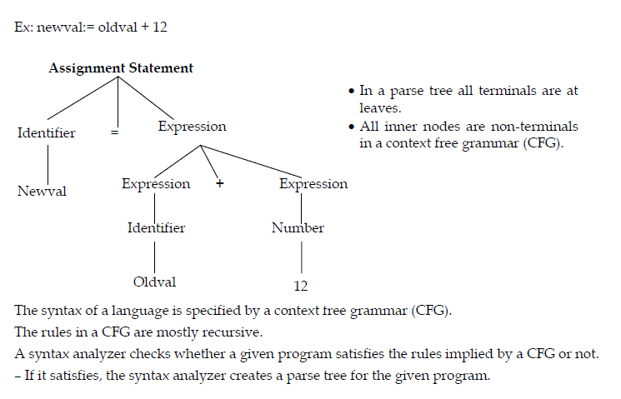

Slide 10
3. Semantic analysis checks the semantic consistency of the code.
It uses the syntax tree of the previous phase along with the symbol table to verify that the given source code is semantically consistent.
It also checks whether the code is conveying an appropriate meaning.
Semantic Analyzer will check for Type mismatches, incompatible operands, a function called with improper arguments, an undeclared variable, etc.
Functions of Semantic analyses phase are:
Helps you to store type information gathered and save it in symbol table or syntax tree
Allows you to perform type checking In the case of type mismatch, where there are no exact type correction rules which satisfy the desired operation a semantic error is shown
Collects type information and checks for type compatibility
Checks if the source language permits the operands or not

Slide 11
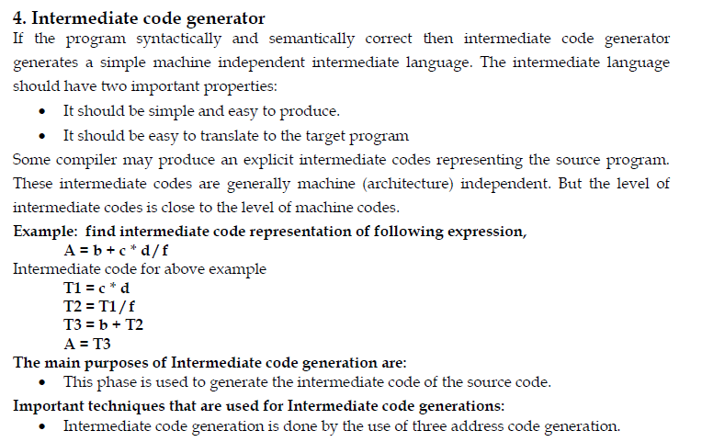

222

Slide 12
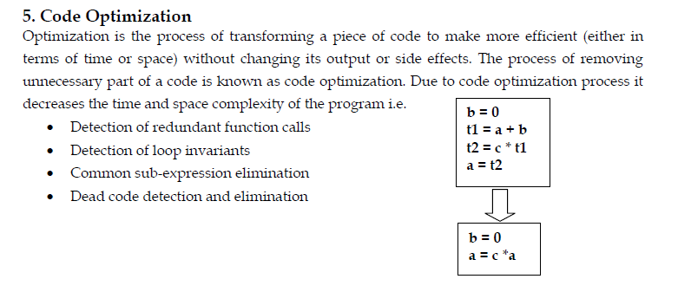

Slide 13
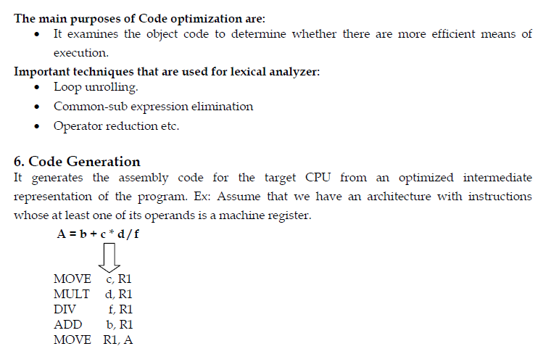
2

Slide 14
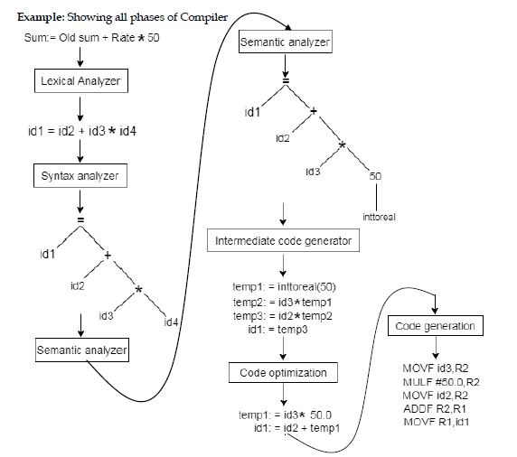

Slide 15
Preprocessor
A preprocessor is a program that processes its input data to produce output that is used as input to another program.
The output is said to be a preprocessed form of the input data, which is often used by some subsequent programs like compilers.
They may perform the following functions
1. Macro processing:
A macro is a rule or pattern that specifies how a certain input sequence should be mapped to an output sequence according to a defined procedure.
The mapping process that instantiates a macro into a specific output sequence is known as macro expan2sion.

Slide 16
2. File Inclusion:
Preprocessor includes header files into the program text.
When the preprocessor finds an #include directive it replaces it by the entire content of the specified file.
3. Rational Preprocessors:
These processors change older languages with more modern flow-of-control and data-structuring facilities.
4. Language extension :
These processors attempt to add capabilities to the language by what amounts to built-in macros.
For example, the language Equel is a database query language embedded in C.

Slide 17
Assembler
Assembler creates object code by translating assembly instruction mnemonics into machine code. There are two types of assemblers:
One-pass assemblers go through the source code once and assume that all symbols will be defined before any instruction that references them.
Two-pass assemblers create a table with all symbols and their values in the first pass, and then use the table in a second pass to generate code

Slide 18
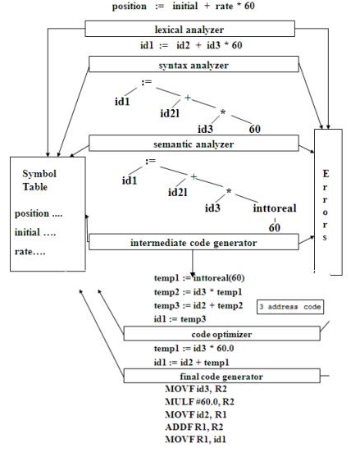
2

Slide 19
Linker and Loader
A linker or link editor is a program that takes one or more objects generated by a compiler and combines them into a single executable program. Three tasks of the linker are
Searches the program to find library routines used by program, e.g. printf(), math routines.
Determines the memory locations that code from each module will occupy and relocates its instructions by adjusting absolute references
Resolves references among files.
A loader is the part of an operating system that is responsible for loading programs in memory, one of the essential stages in the process of starting a program.

Slide 20
